Slide 1
Basics of “C”

Slide 2
Objectives
Understand the basic structure of a program in C.
Learn the commands used in UNIX/LINUX and MS-DOS for compiling and running a program in C.
Obtain a preliminary idea of the keywords in C.
Learn the data types, variables, constants, operators, and expressions in C.
Understand and grasp the precedence and associativity rules of operators in C.
Get acquainted with the rules of type conversions in C.

Slide 3
Key Words
ASCII : It is a standard code for representing characters as numbers that is used on most microcomputers, computer terminals, and printers. In addition to printable characters, the ASCII code includes control characters to indicate carriage return, backspace, etc.
Assembler :The assembler creates the object code.
Associativity :The associativity of operators determines the order in which operators of equal precedence are evaluated when they occur in the same expression. Most operators have a left-to-right associativity, but some have right-to-left associativity.

Slide 4
Key Words
Compiler: A system software that translates the source code to assembly code.
Constant :A constant is an entity that doesn’t change.
Data type: The type, or data type, of a variable determines a set of values that the variable might take and a set of operations that can be applied to those values.
Debugger: A debugger is a program that enables you to run another program step-by-step and examine the value of that program’s variables.
Identifier: An identifier is a symbolic name used in a program and defined by the programmer. Ex : name of variables, arrays, functions etc like emp_name, total_amount

Slide 5
Key Words
IDE :An Integrated Development Environment or IDE is an editor which offers a complete environment for writing, developing, modifying, deploying, testing, and debugging the programs.
Identifier: An identifier or name is a sequence of characters invented by the programmer to identify or name a specific object.
Keyword: Keywords are explicitly reserved words that have a strict meaning as individual tokens to the compiler. They cannot be redefined or used in other contexts.

Slide 6
Key Words
Linker: If a source file references library functions or functions defined in other source files, the linker combines these functions to create an executable file.
Precedence :The precedence of operators determines the order in which different operators are evaluated when they occur in the same expression. Operators of higher precedence are applied before operators of lower precedence.
Pre processor :The C pre processor is used to modify the source program before compilation according to the pre processor directives specified.

Slide 7
Key Words
L-value: An l-value is an expression to which a value can be assigned.
R-value :An r-value can be defined as an expression that can be assigned to an l-value.
Token: A token is one or more symbols understood by the compiler that help it interpret your code.
Word :A word is the natural unit of memory for a given computer design. The word size is the computer’s preferred size for moving units of information around; technically it’s the width of the processor’s registers.

Slide 8
Key Words
Whitespace Space, newline, tab character and comment are collectively known as whitespace.
Variable: A variable is a named memory location. Every variable has a type, which defines the possible values that the variable can take, and an identifier, which is the name by which the variable is referred.
Bug:Any type of error in a program is known as bug. There are three types of errors that may occur:
Compile errors,
Linking errors,
Runtime errors

Slide 9
Why Learn “C” ?
There are a large number of programming languages in the world today even so, there are several reasons to learn C, some of which are stated as follows:
a . C is quick.
b . C is a core language : In computing, C is a general purpose, cross-platform, block structured procedural, imperative computer programming language.
c . C is a small language: C has only thirty-two keywords. This makes it relatively easy to learn compared to bulkier languages.
d . C is portable.

Slide 10
Developing Programs in “C”
There are mainly three steps:
1. Writing the C program
2. Compiling the program and
3. Executing it.
For these steps, some software components are required, namely an operating system, a text editor(integrated development environment), the C compiler, assembler, and linker.
C uses a semicolon as a statement terminator; the semicolon is required as a signal to the compiler to indicate that a statement is complete.
All program instructions, which are also called statements, have to be written in lower case characters.

Slide 11
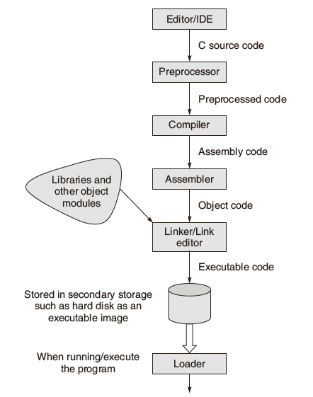
Developing Programs in “C”

Slide 12
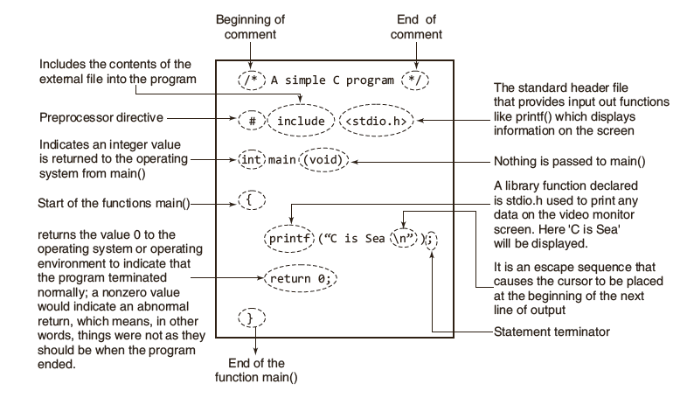
Illustrated Version of a Program

Slide 13
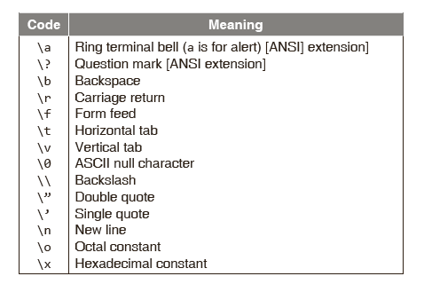
Backlash Code

Slide 14
Parts of C Program
Header File
The header files, usually incorporate data types, function declarations and macros, resolves this issue. The file with .h extension is called header file, because it’s usually included at the head of a program.
Every C compiler that conforms to the international standard (ISO/IEC 9899) for the language will have a set of standard header files supplied with it.
The header files primarily contain declarations relating to standard library functions and macros that are available with C.

Slide 15
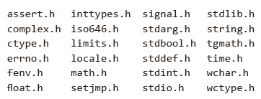
Standard Header Files
During compilation, the compilers perform type checking to ensure that the calls to the library and other user-defined functions are correct. This form of checking helps to ensure the semantic correctness of the program.

Slide 16
Philosophy : main()
main() is a user defined function. main() is the first function in the program which gets called when the program executes. The start up code c calls main() function. We can’t change the name of the main() function.
main() is must.
According to ANSI/ISO/IEC 9899:1990 International Standard for C, the function called at program start up is named main. The implementation declares no prototype for this function. It can be defined with no parameters:
int main(void) { /* ... */ }
or with two parameters (referred to here as argc and argv) :
int main(int argc, char *argv[ ]) { /* ... */ }

Slide 17
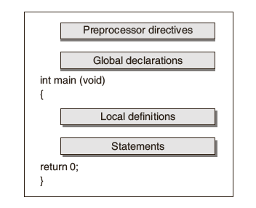
Structure : C Program

Slide 18
Declaration & Definition
Declaration means describing the type of a data object to the compiler but not allocating any space for it.
A declaration announces the properties of a data object or a function. If a variable or function is declared and then later make reference to it with data objects that do not match the types in the declaration, the compiler will complain.
data_type variable_name_1,
Definition means declaration of a data object and also allocating space to hold the data object.
A definition, on the other hand, actually sets aside storage space (in the case of a data object) or indicates the sequence of statements to be carried out (in the case of a function).

Slide 19
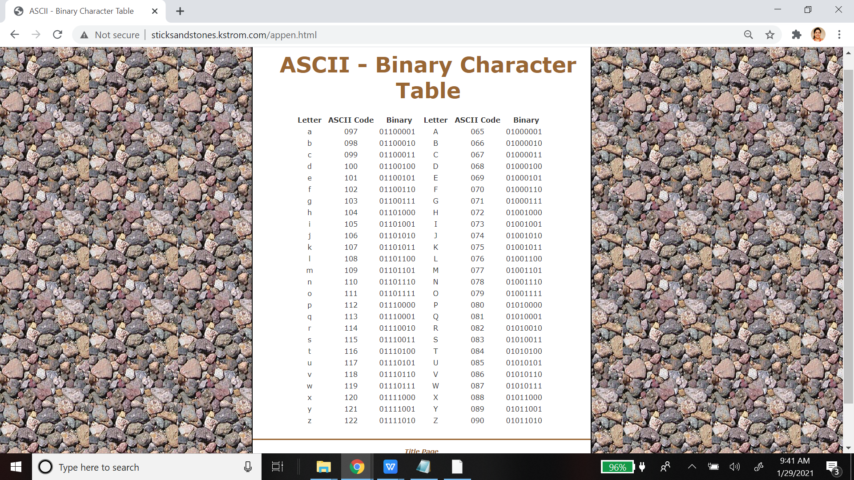

Slide 20
Variables : Attributes
All variables have three important attributes:
A data type that is established when the variable is defined, e.g., integer, real, character. Once defined , the type of a C variable cannot be changed.
A name of the variable.
A value that can be changed by assigning a new value to the variable. The kind of values a variable can assume depends on its type. For example, an integer variable can only take integer values, e.g., 2, 100, –12.

Slide 21
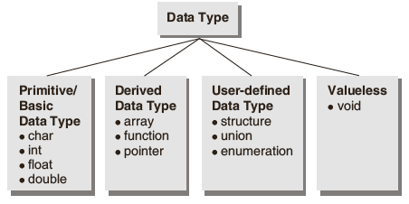

Classification : Data Types

Slide 22
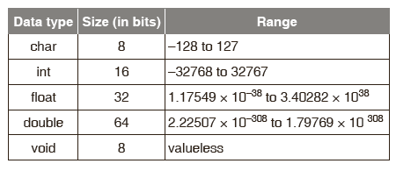
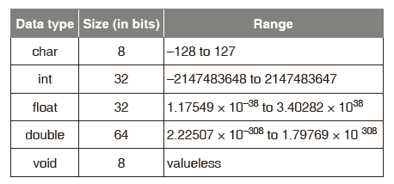
Basic Data Types : Size & Range
16 bit computer:
32 bit computer:

Slide 23
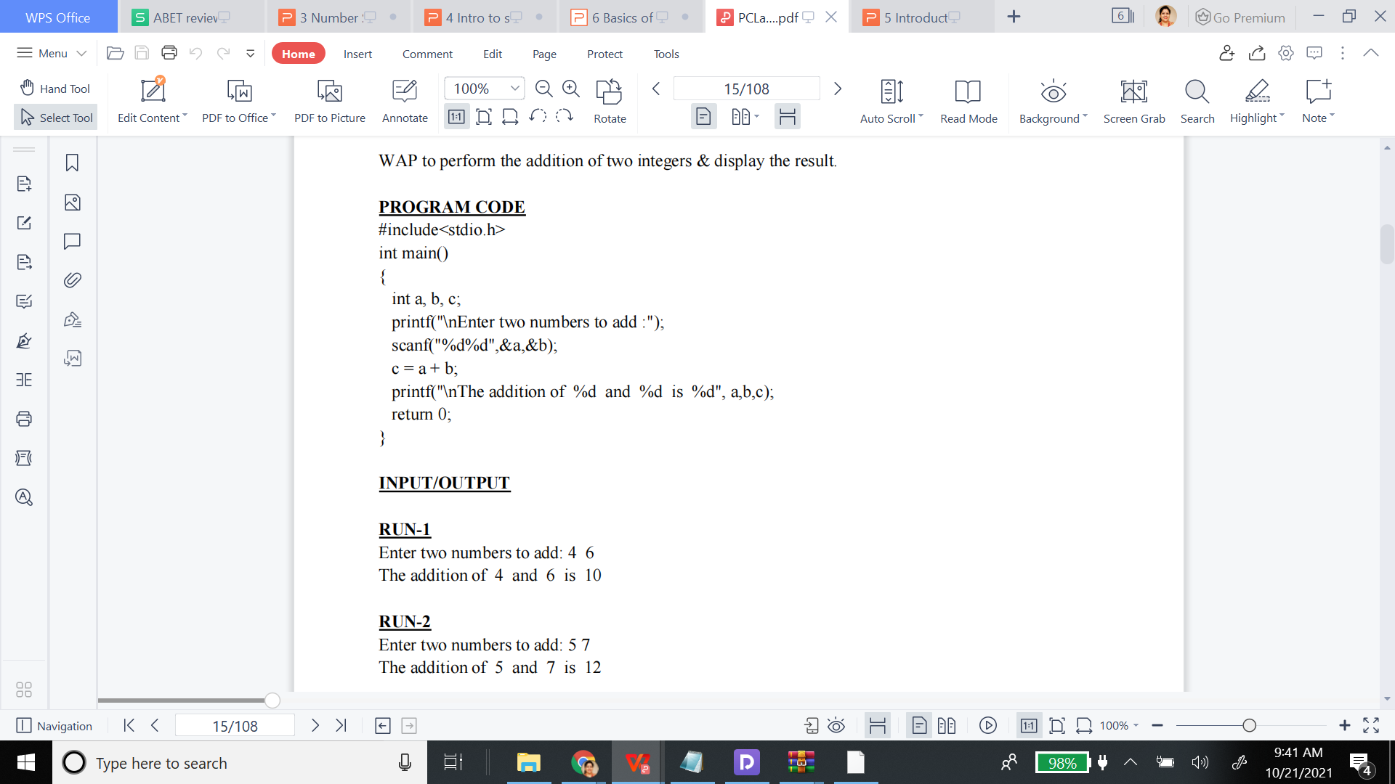

Slide 24
Specifiers or Modifiers
In addition, C has four type specifiers or modifiers and three type qualifiers.
Each of these type modifiers can be applied to the base type int.
The modifiers signed and unsigned can also be applied to the base type char.
In addition, long can be applied to double.
When the base type is omitted from a declaration, int is assumed.
The type void does not have these modifiers.

Slide 25
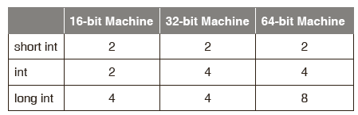
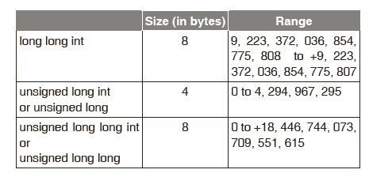
Specifiers : Data Types
The specifiers and qualifiers for the data types can be broadly classified into three types:
Size specifiers— short and long
Sign specifiers— signed and unsigned
Type qualifiers— const, volatile and restrict

Slide 26
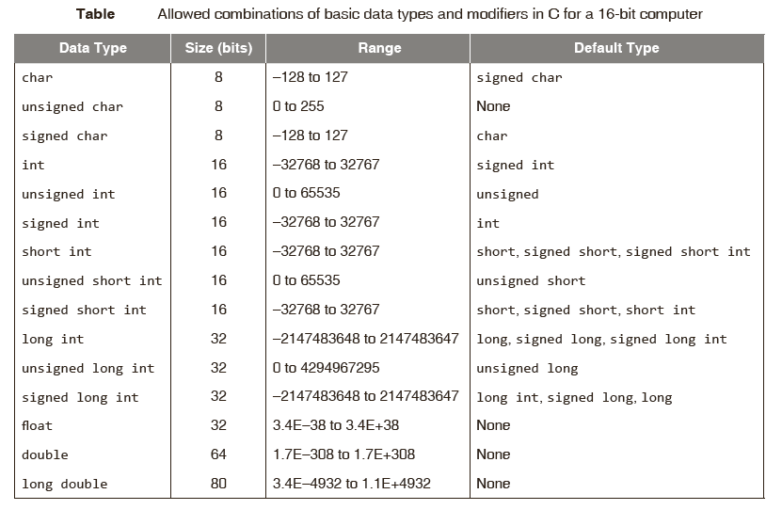
Specifiers : Data Types

Slide 27
Qualifiers
Modifies the properties of a variable
Controls the way variables may be accessed or modified.
Const – read only variable, will never change by the program
Const float pi = 3.14
Volatile –unexpectedly change by events outside the program (directly linked with component)
if global variable’s address is passed to clock routine of the operating system to store the system time, the value in this address keep on changing without any assignment by the program. These variables are named as volatile variable.

Slide 28
2. WAP to perform the addition of two integers & display the result.
Program Code
#include<stdio.h>
int main()
{
int a, b, c;
printf("\nEnter two numbers to add :");
scanf("%d%d",&a,&b);
c = a + b;
printf("\nThe addition of %d and %d is %d", a,b,c);
return 0;
}
Q1. Declare some int variable and store different values and display them
a = 20, b = ‘A’, c = 2.09
Q2. Input 2 Integer values and display the addition
Q3.4 programs
Input 2 int values and display the addition(+), subtraction(-), multiplication(*) division(/) and modular division(%)

Slide 29
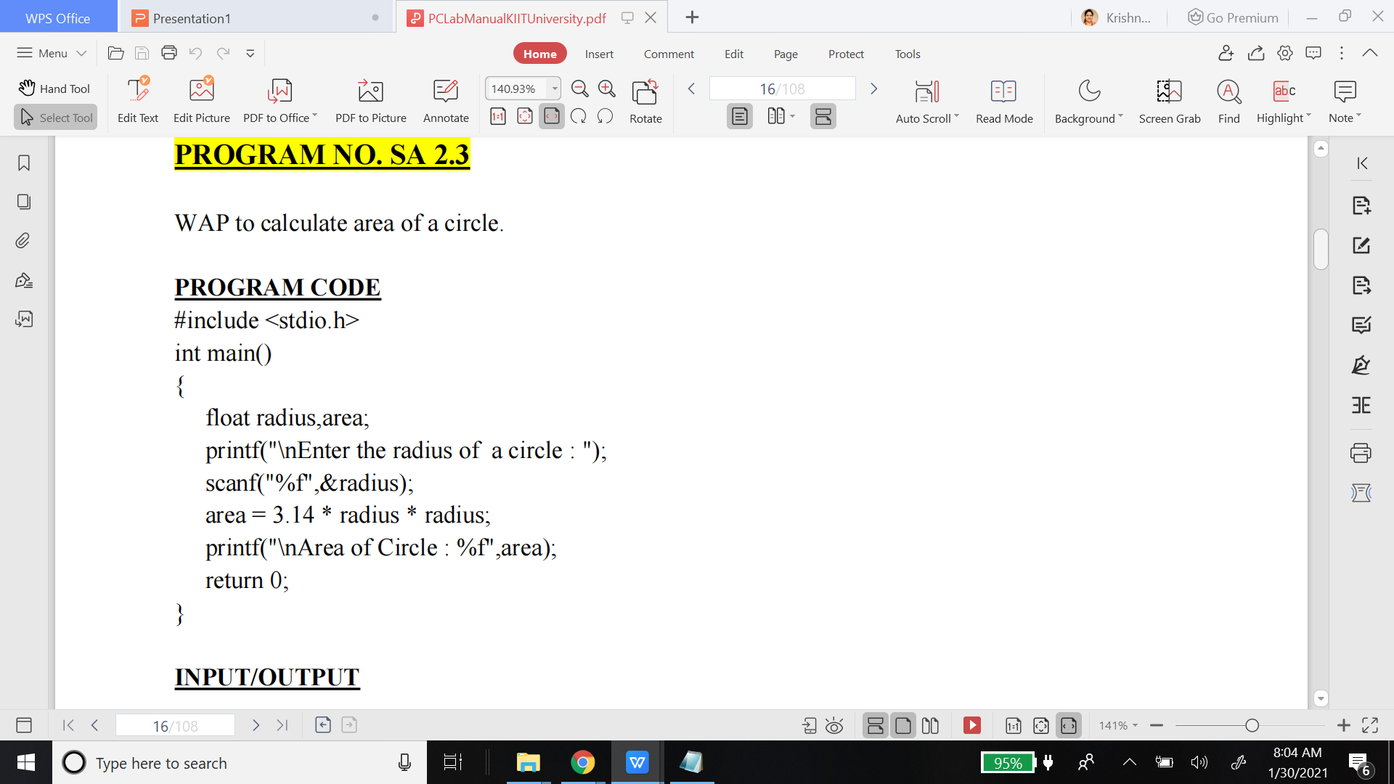
1. Program 1 - WAP to calculate area and the perimiter of a circle.
2. Program 2 - Calculate the area of a rectangle (take two values as input = lenth, Width)

Slide 30
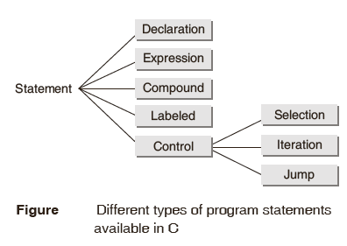
Program Statements
A statement is a syntactic constructions that performs an action when a program is executed. All C program statements are terminated with a semi-colon (;).

Slide 31
Program Statements
Declaration :It is a program statement that serves to communicate to the language translator information about the name and type of the data objects needed during program execution.
int a;
int b;
int c;
Or int a,b,c;
This line informs the C compiler that it needs to allocate space for 5 integers
Expression statement: It is the simplest kind of statement which is no more than an expression followed by a semicolon. An expression is a sequence of operators and operands that specifies computation of a value . Example :x = 4

Slide 32
Program Statements
Compound statement is a sequence of statements that may be treated as a single statement in the construction of larger statements.
A compound statement (also called a "block") typically appears as the body of another statement, such as the if statement
if ( i > 0 )
{
line[i] = x;
x++;
i--;
}

Slide 33
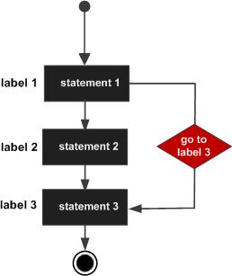
Program Statements
Labelled statements can be used to mark any statement so that control may be transferred to the statement by switch statement
goto label;
.. .
label: statement;

Slide 34
Program Statements
Control statement is a statement whose execution results in a choice being made as to which of two or more paths should be followed. In other words, the control statements determine the ‘flow of control’ in a program.
Selection statements allow a program to select a particular execution path from a set of one or more alternatives. Various forms of the if..else statement belong to this category.
Iteration statements are used to execute a group of one or more statements repeatedly. “while, for, and do..while” statements falls under this group.
Jump statements cause an unconditional jump to some other place in the program. Goto statement falls in this group

Slide 35
Program Statements(control)
if (expression)
{
Block of statements;
}
else if(expression)
{
Block of statements;
}
else
{
Block of statements;
}
while ( expression )
{
Single statement
or
Block of statements;
}
for( expr1; expr2; expr3)
{
Single statement
or Block of statements;
}

Slide 36
Program Statements(control)
do
{
Single statement
or Block of statements;
}while(expression);

Slide 37
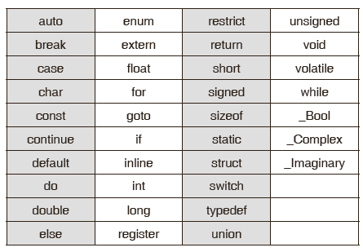
Key Words
Compiler vendors (like Microsoft, Borland ,etc.) provide their own keywords apart from the ones mentioned below. These include extended keywords like near, far, asm, etc.

Slide 38
Constants
A constant is an explicit data value written by the programmer. Thus, it is a value known to the compiler at compiling time.
In ANSI C, a decimal integer constant is treated as an unsigned long if its magnitude exceeds that of the signed long. An octal or hexadecimal integer that exceeds the limit of int is taken to be unsigned; if it exceeds this limit, it is taken to be long; and if it exceeds this limit, it is treated as an unsigned long.
An integer constant is regarded as unsigned if its value is followed by the letter ‘u’ or ‘U’, e.g.,0x9999u;

Slide 39
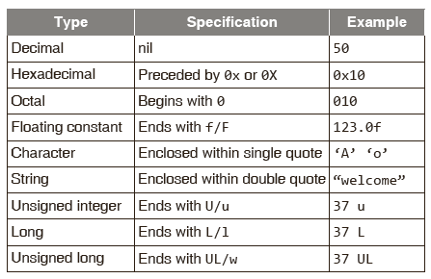
Specifications of Different Constants

Slide 40

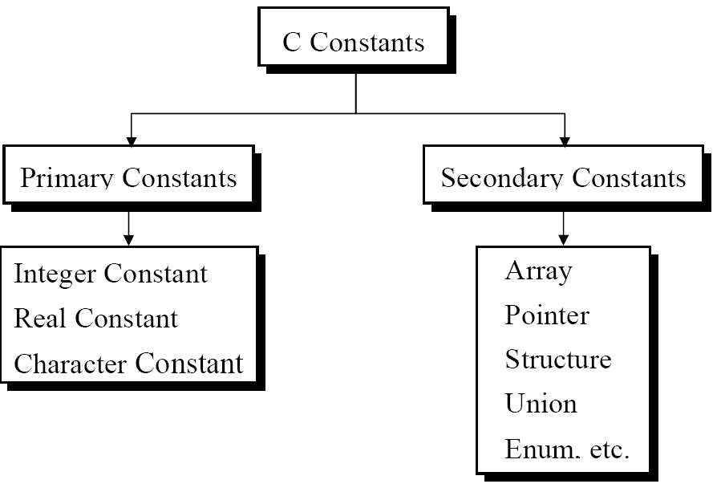
Types of C Constant

Slide 41
Rules for Constructing Const
Constructing Integer Const
Ex.: 426
+782
-8000
-7605
Must have at least one digit.
Must not have a decimal point.
Can be either positive or negative
If no sign precedes an integer constant it is assumed to be positive.
No commas or blanks are allowed
Constructing Real Const in fractional form
Real constants are often called Floating Point constants. The real constants could be written in two forms—Fractional form and Exponential form. Following rules must be observed while constructing real constants expressed in fractional form:
Must have at least one digit.
Must have a decimal point.
Could be either positive or negative.
Default sign is positive.
No commas or blanks are allowed.
Ex.: +325.34
426.0
-32.76
-48.5792

Slide 42
Rules for Constructing Const
Constructing Real Const in exponential form
The exponential form of representation of real constants is usually used if the value of the constant is either too small or too large. It however doesn’t restrict us in any way from using exponential form of representation for other real constants.
In exponential form of representation, the real constant is represented in two parts. The part appearing before ‘e’ is called mantissa, whereas the part following ‘e’ is called exponent.
Following rules must be observed while constructing real constants expressed in exponential form:
The mantissa part and the exponential part should be separated by a letter e.
The mantissa part may have a positive or negative sign.
Default sign of mantissa part is positive.
The exponent must have at least one digit, which must be a positive
or negative integer. Default sign is positive.
Ex.: +3.2e-5
4.1e8
-0.2e+3
-3.2e-5

Slide 43
Rules for Constructing Const
Constructing Character Const
Is a single alphabet, a single digit or a single special symbol enclosed within single inverted commas. Both the inverted commas should point to the left. For example, ’A’ is a valid character constant whereas ‘A’ is not.
The maximum length can be 1 character.
Ex.: 'A'
'I'
'5'
'='
Note : 3.2e^-5 = 3.2(10)^-5
3.14159 /* Legal */
314159E-5L /* Legal */
510E /* Illegal: incomplete exponent */
210f /* Illegal: no decimal or exponent */ .e55 /* Illegal: missing integer or fraction */

Slide 44
Constant example
#include <stdio.h>
void main()
{
const int height = 100; /*int constant*/
const float number = 3.14; /*Real constant*/
const char letter = 'A'; /*char constant*/
const char letter_sequence[10] = "ABC"; /*string constant*/
const char backslash_char = '\?'; /*special char cnst*/
printf("value of height :%d \n", height );
printf("value of number : %f \n", number );
printf("value of letter : %c \n", letter );
printf("value of letter_sequence : %s \n", letter_sequence);
printf("value of backslash_char : %c \n", backslash_char);
}
value of height : 100 value of number : 3.140000 value of letter : A value of letter_sequence : ABC value of backslash_char : ?

Slide 45
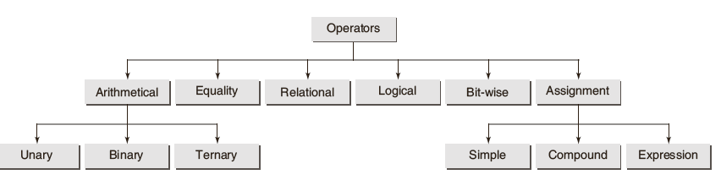
Classification : Operations in C

Slide 46
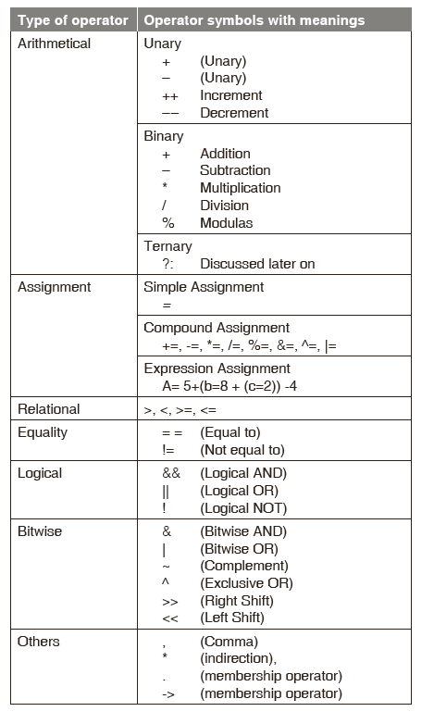
Different Operators

Slide 47
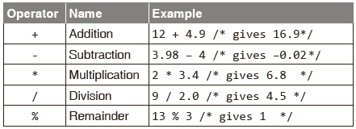
Arithmetic Operators
There are three types of arithmetic operators in C:binary,unary, and ternary.
Binary operators: C provides five basic arithmetic binary operators.
Arithmetic binary operators:

Slide 48
Unary Operators
Unary operators: The unary operators operate on a single operand and following are the examples of Unary operators:.
Unary increment and decrement operators ‘++’ and ‘--’ operators increment or decrement the value in a variable by 1.
Basic rules for using ++ and – – operators:
The operand must be a variable but not a constant or an expression.
The operator ++ and -- may precede or succeed the operand.

Slide 49
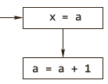
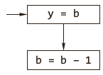
Postfix
Postfix:
(a) x = a++;
First action: store value of a in memory location for variable x.
Second action: increment value of a by 1 and store result in memory location for variable a.
(b) y = b––;
First action: put value of b in memory location for variable y.
Second action: decrement value of b by 1 and put result in memory location for variable b.

Slide 50
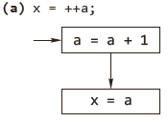
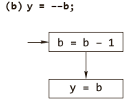
Prefix
Prefix :
(a) x = ++a;
First action: increment value of a by 1 and store result in memory location for variable a.
Second action: store value of a in memory location for variable x.
(b) y = ––b;
First action: decrement value of b by 1 and put result in memory location for variable b.
Second action: put value of b in memory location for variable y.

Slide 51
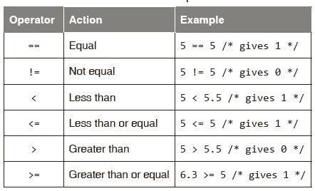
Relational Operators
C provides six relational operators for comparing numeric quantities. Relational operators evaluate to 1, representing the true outcome, or 0, representing the false outcome.

Slide 52
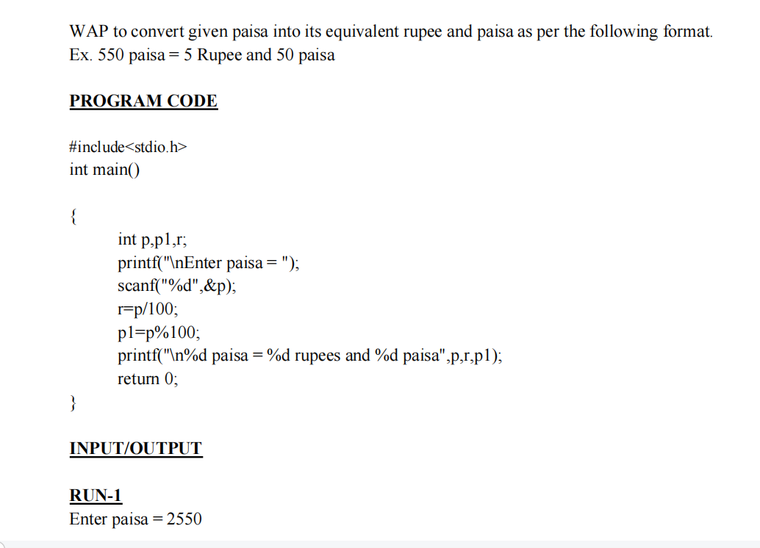

Slide 53
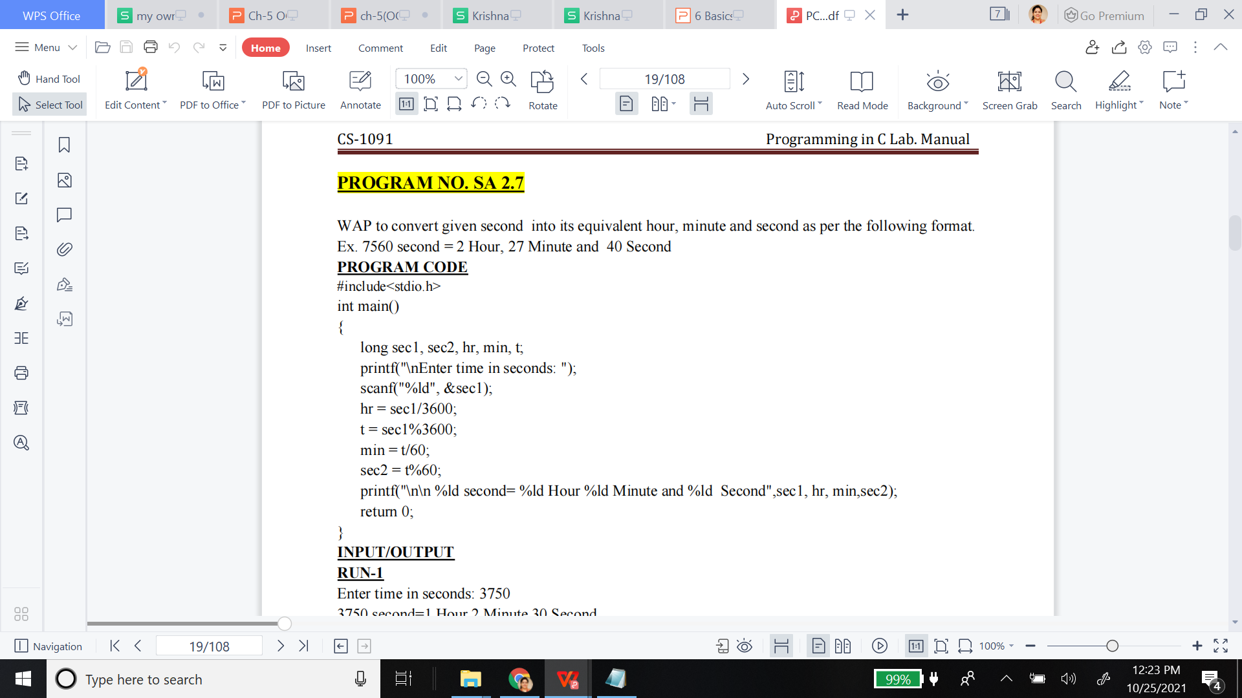

Slide 54
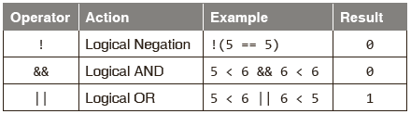
Logical Operators
C provides three logical operators for forming logical expressions. Like the relational operators, logical operators evaluate to 1 or 0.
Logical negation is a unary operator that negates the logical value of its single operand. If its operand is non-zero, it produces 0, and if it is 0, it produces 1.
Logical AND produces 0 if one or both its operands evaluate to 0. Otherwise, it produces 1 (both true in this case of 1).
Logical OR produces 0 if both its operands evaluate to 0. Otherwise , it produces 1 (if any one is true).

Slide 55
Bitwise Operators
C provides six bitwise operators for manipulating the individual bits in an integer quantity . Bitwise operators expect their operands to be integer quantities and treat them as bit sequences.
Bitwise negation is a unary operator that complements the bits in its operands.
Bitwise AND compares the corresponding bits of its operands and produces a 1 when both bits are 1, and 0 otherwise.
Bitwise OR compares the corresponding bits of its operands and produces a 0 when both bits are 0, and 1 otherwise.
Bitwise exclusive or compares the corresponding bits of its operands and produces a 0 when both bits are 1 or both bits are 0, and 1 otherwise.

Slide 56
A = 0011 1100 (60)
B = 0000 1101 (13)
Bitwise Operators
OP | Description | Example
& | Binary AND Operator copies a bit to the result if it exists in both operands. | (A & B) = 12, i.e., 0000 1100
| | Binary OR Operator copies a bit if it exists in either operand. | (A | B) = 61, i.e., 0011 1101
^ | Binary XOR Operator copies the bit if it is set in one operand but not both. | (A ^ B) = 49, i.e., 0011 0001
~ | Binary Ones Complement Operator is unary and has the effect of 'flipping' bits. | (~A ) 1100 0011
<< | Binary Left Shift Operator. The left operands value is moved left by the number of bits specified by the right operand. | A << 2 1111 0000
>> | Binary Right Shift Operator. The left operands value is moved right by the number of bits specified by the right operand. | A >> 2 0000 1111

Slide 57
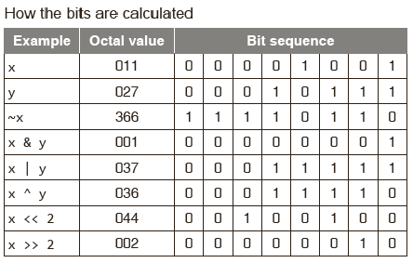
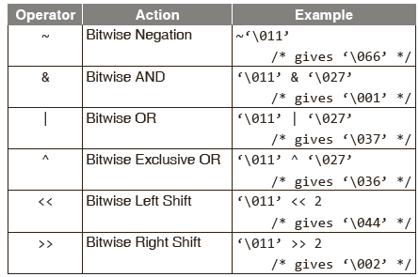
Bitwise Operators

Slide 58
Assignment Operators
Operator | Description | Example
= | Simple assignment operator. Assigns values from right side operands to left side operand. | C = A + B will assign the value of A + B to C
+= | Add AND assignment operator. It adds the right operand to the left operand and assign the result to the left operand. | C += A is equivalent to C = C + A
−= | Subtract AND assignment operator. It subtracts the right operand from the left operand and assigns the result to the left operand. | C −= A is equivalent to C = C − A
*= | Multiply AND assignment operator. It multiplies the right operand with the left operand and assigns the result to the left operand. | C *= A is equivalent to C = C * A
/= | Divide AND assignment operator. It divides the left operand with the right operand and assigns the result to the left operand. | C /= A is equivalent to C = C / A

Slide 59
Assignment Operators
Operator | Description | Example
%= | Modulus AND assignment operator. It takes modulus using two operands and assigns the result to the left operand. | C %= A is equivalent to C = C % A
<<= | Left shift AND assignment operator. | C <<= 2 is same as C = C << 2
>>= | Right shift AND assignment operator. | C >>= 2 is same as C = C >> 2
&= | Bitwise AND assignment operator. | C &= 2 is same as C = C & 2
^= | Bitwise exclusive OR and assignment operator. | C ^= 2 is same as C = C ^ 2
|= | Bitwise inclusive OR and assignment operator. | C |= 2 is same as C = C | 2

Slide 60
Example
#include <stdio.h>
main()
{
int a = 21;
int c ;
c = a; printf("Line 1 - = Operator Example, Value of c = %d\n", c );
c += a; printf("Line 2 - += Operator Example, Value of c = %d\n", c );
c -= a; printf("Line 3 - -= Operator Example, Value of c = %d\n", c );
c *= a; printf("Line 4 - *= Operator Example, Value of c = %d\n", c );
c /= a; printf("Line 5 - /= Operator Example, Value of c = %d\n", c );
c = 200;
c %= a; printf("Line 6 - %= Operator Example, Value of c = %d\n", c );
}
Line 1 - = Operator Example, Value of c = 21
Line 2 - += Operator Example, Value of c = 42
Line 3 - -= Operator Example, Value of c = 21
Line 4 - *= Operator Example, Value of c = 441
Line 5 - /= Operator Example, Value of c = 21
Line 6 - %= Operator Example, Value of c = 11

Slide 61
Conditional Operators
The conditional operator has three expressions (ternary).
It has the general form
expression1 ? expression2 : expression3
First, expression1 is evaluated; it is treated as a logical condition.
If the result is non-zero, then expression2 is evaluated and its value is the final result. Otherwise, expression3 is evaluated and its value is the final result.
For example,int m = 1, n = 2, min;
min = (m < n ? m : n); /* min is assigned a value 1 */
In the above example, because m is less than n, m<n expression evaluates to be true, therefore, min is assigned the value m, i.e., 1.

Slide 62
Conditional Operators
#include <stdio.h>
main()
{
int a , b;
a = 10;
printf( "Value of b is %d\n", (a == 1) ? 20: 30 );
printf( "Value of b is %d\n", (a == 10) ? 20: 30 );
}
This will produce following result:
Value of b is 30
Value of b is 20

Slide 63
Comma Operators
This operator allows the evaluation of multiple expressions, separated by the comma, from left to right in order and the evaluated value of the rightmost expression is accepted as the final result. The general form of an expression using a comma operator is
Expression M = (expression1, expression2, …,expression N);
where the expressions are evaluated strictly from left to right and their values discarded, except for the last one, whose type and value determine the result of the overall expression.
void main()
{ int num1 = 1, num2 = 2; /*separator*/
int res; res = (num1, num2); /* operator*/
printf("%d", res); } .... Gives output as num2

Slide 64
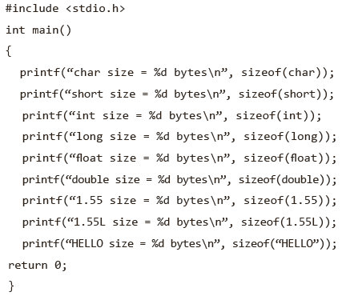
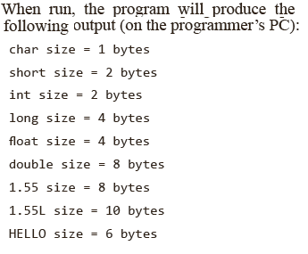
Sizeof Operators
C provides a useful operator, sizeof, for calculating the size of any data item or type. It takes a single operand that may be a type name (e.g., int) or an expression (e.g.,100) and returns the size of the specified entity in bytes .The outcome is totally machine-dependent.
For example:

Slide 65
Expression Evolution : Precedence & Associativity
Precedence of operators
If more than one operators are involved in an expression, C language has a predefined rule of priority for the operators. This rule of priority of operators is called operator precedence.
In C, precedence of
Arithmetic operators( *, %, /, +, -)
Relational operators(==, !=, >, <, >=, <=)
Logical operators(&&, || and !).
Example of precedence
(1 > 2 + 3 && 4)
This expression is equivalent to: ((1 > (2 + 3)) && 4)
i.e, (2 + 3) executes first resulting into 5 then, first part of the expression (1 > 5) executes resulting into 0 (false) then, (0 && 4) executes resulting into 0 (false)
Output - 0
high

Slide 66
Expression Evolution : Precedence & Associativity
Associativity of operators
If two operators of same precedence (priority) is present in an expression, Associativity of operators indicate the order in which they execute.
Example of associativity
1 == 2 != 3
Here, operators == and != have same precedence.
The associativity of both == and != is left to right, i.e, the expression on the left is executed first and moves towards the right.
Thus, the expression above is equivalent to :
((1 == 2) != 3)
i.e, (1 == 2) executes first resulting into 0 (false)
then, (0 != 3)
executes resulting into 1 (true)

Slide 67
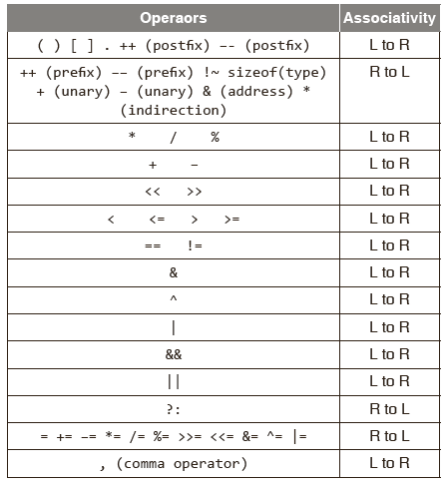
Expression Evolution : Precedence & Associativity
Evaluation of an expression in C is very important to understand. Unfortunately there is no ‘BODMAS’ rule in C language as found in algebra.
The precedence of operators determines the order in which different operators are evaluated when they occur in the same expression. Operators of higher precedence are applied before operators of lower precedence.

Slide 68
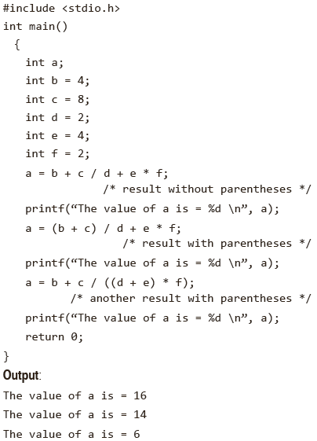
Example : Associativity of Operator

Slide 69
L-Values & R-Values
An l- value is an expression to which a value can be assigned.
An r- value can be defined as an expression that can be assigned to an l- value.
The l- value expression is located on the left side of an assignment statement, whereas an r- value is located on the right side of an assignment statement.
The address associated with a program variable in C is called its l- value; the contents of that location are its r- value, the quantity that is supposed to be the value of the variable.
The r- value of a variable may change as program execution proceeds; but never its l- value.

Slide 70
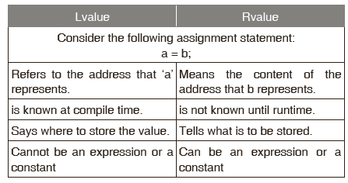
L-Values & R-Values
For example :
a = b;
b, on the right-hand side of the assignment operator, is the quantity to be found at the address associated with b, i.e., an r- value. a is assigned the value stored in the address associated with b. a, on the left-hand side, is the address at which the contents are altered as a result of the assignment. a is an l- value. The assignment operation deposits b’s r- value at a’s l- value.

Slide 71
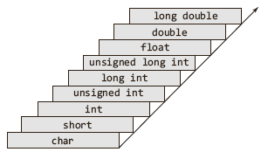
Type Conversion
Though the C compiler performs automatic type conversions, the programmer should be aware of what is going on so as to understand how C evaluates expressions.
When a C expression is evaluated, the resulting value has a particular data type. If all the variables in the expression are of the same type, the resulting type is of the same type as well. For example, if x and y are both of int type , the expression x +y is of int type as well.
The smallest to the largest data types conversion with respect to size is along the arrow as shown below:

Slide 72
RULE : Type Conversion
Type casting is a way to convert a variable from one data type to another data type. For example, if you want to store a 'long' value into a simple integer then you can type cast 'long' to 'int'. You can convert the values from one type to another explicitly using the cast operator
#include <stdio.h>
main()
{
int sum = 17, count = 5;
double mean;
mean = (double) sum / count;
printf("Value of mean : %f\n", mean );
}
Output
Value of mean : 3.400000

Slide 73
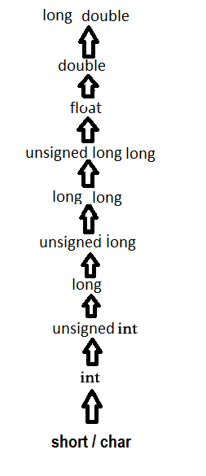
RULE : Type Conversion
The usual arithmetic conversions are implicitly performed to cast their values to a common type. The compiler first performs integer promotion (convert to int); if the operands still have different types, then they are converted to the type that appears highest in the following hierarchy
char or short (signed or unsigned) are converted to int (signed or unsigned).
float operands are converted to double.
If any one operand is double, the other operand is also converted to double, and that is the type of the result;
If any one operand is long, the other operand is treated as long, and that is the type of the result;
If any one operand is of type unsigned, the other operand is converted to unsigned, and that is also the type of the result.

Slide 74
RULE : Type Conversion
#include <stdio.h>
main()
{
int i = 17;
char c = 'c'; /* ascii value is 99 */
float sum;
sum = i + c;
printf("Value of sum : %f\n", sum );
}
When the above code is compiled and executed, it produces the following result −
Value of sum : 116.000000

Slide 75
program : swap two numbers
a=b
b=a ??

Slide 76
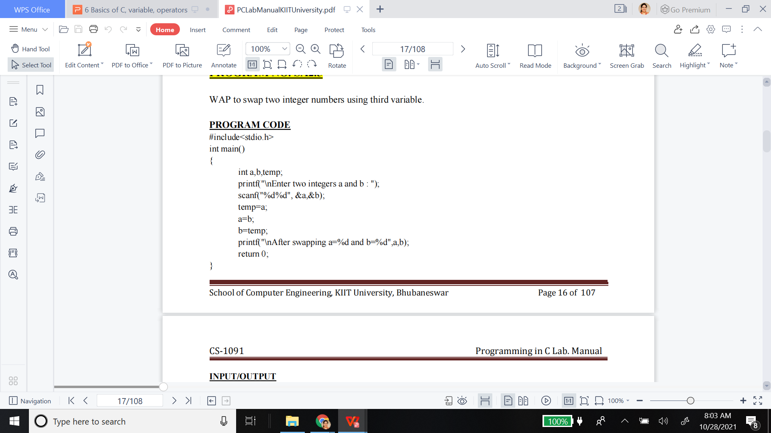
SWAP two numbers
RUN-1
Enter two integers a and b : 2 3
After swapping a=3 and b=2
RUN-2
Enter two integers a and b : 10 20
After swapping a=20 and b=10

Slide 77
Program = add two times
s, s1, s2
m, m1, m2
h, h1, h2
day ?

Slide 78
#include<stdio.h>
main()
{
int h,m,s,h1,m1,s1,h2,m2,s2,day;
printf("Enter first hours,minutes and seconds\n");
scanf("%d%d%d",&h1,&m1,&s1);
printf("Enter second hours,minutes and seconds\n");
scanf("%d%d%d",&h2,&m2,&s2);
s=h=m=day=0;
s=s1+s2;
if(s>60)
{
m=s/60;
s=s%60;
}
m=m+m1+m2;
if(m>60)
{
h=m/60;
m=m%60;
}
h=h+h1+h2;
if(h>24)
{
day=1;
h=h%24;
}
printf("First time = %d:%d:%d",h1,m1,s1);
printf("\nSecond time = %d:%d:%d",h2,m2,s2);
printf("\nAdded time =");
if(day==0)
printf("%d:%d:%d\n",h,m,s);
else
{
printf("%d day",day);
printf("%d:%d:%d\n",h,m,s);
}
}

